Slide 1

Hive
September 2012

Slide 2
Introduction
Hive, a framework for data warehousing on top of Hadoop.
Hadoop has Storage (HDFS) and Processing(MAP REDUCE).
Hive grew from a need to manage and learn from the huge volumes of data.
REAL TIME EXAMPLE –FACEBOOK.
Hive was created to make it possible for analysts with strong SQL skills to run queries on the huge volumes of data that Facebook Stored in HDFS.

Slide 3
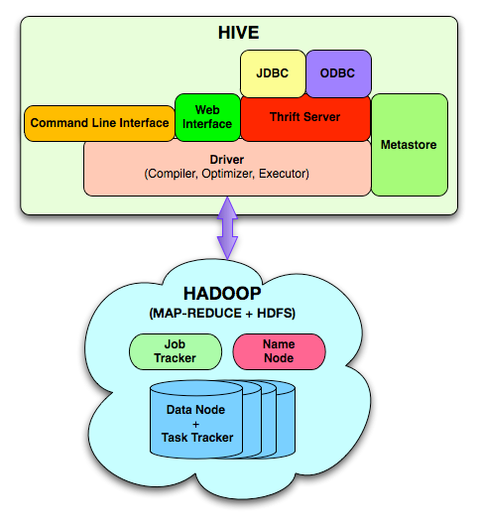
Hive architecture

Slide 4
Architecture
Metastore: The metastore is the central repository of Hive metadata
stores system catalog.
By default, the metastore service runs in the same JVM as the Hive service
and contains an embedded Derby database instance backed by the local disk.
Driver: manages life cycle of HiveQL query as it moves thru’ HIVE; also manages session handle and session statistics
Query compiler: Compiles HiveQL into a directed acyclic graph of map/reduce tasks
Execution engines: The component executes the tasks in proper dependency order; interacts with Hadoop
HiveServer: provides Thrift interface and JDBC/ODBC for integrating
other applications.

Slide 5
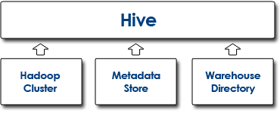
Components of Hive

Slide 6
Data Model
Hive structures data into well-understood database concepts such as: tables, rows, cols, partitions
It supports primitive types: integers, floats, doubles, and strings
Hive also supports:
associative arrays: map<key-type, value-type>
Lists: list<element type>
Structs: struct<file name: file type…>
SerDe: serialize and deserialized API is used to move data in and out of tables

Slide 7
Query Language (HiveQL)
Subset of SQL
Limited equality and join predicates
No inserts on existing tables
Can overwrite an entire table
 | Hive Query Language (HQL)
Application | Create Data Structures | Loading Data into Tables | Queries on table data
Example Functions | CREATE/DROP table, ALTER table, CREATE/DROP view, CREATE/DROP function, SHOW/DESCRIBE | LOAD DATA INTO table INSERT OVERWRITE TABLE | SELECT ..WHERE.. GROUP BY SORT BY ORDER BY JOIN UNION EXPLAIN

Slide 8
Situation | Description
LOAD DATA INTO ... | Storage Location of Data
SORT BY and ORDER BY | SORT BY sorts per reducer whereas ORDER BY enforces total order across the entire dataset
DISTRIBUTE BY and CLUSTER BY | Hive uses the columns in DISTRIBUTE BY to distribute the rows among reducers. CLUSTER BY is a short cut for both DISTRIBUTE BY and SORT BY.
Hive does not have the SQL statements: INSERT UPDATE DELETE | Hive (and Hadoop) technologies are designed for Data Warehousing type applications (or write once, read many times). This is the underlying reason why these fundamental SQL statements are not available in Hive. Most of the functionality of SQL statements INSERT, UPDATE and DELETE can be replicated through the use of the INSERT OVERWRITE TABLE.

Slide 9
Hive does not support PRIMARY KEY FOREIGN KEY CREATE INDEX | The nature of Hadoop (and Hive which executes on Hadoop) does not support indexes in tables. for this reason there are no functions to support creating indexes an keys.
JOIN syntax | Inner, outer and left semi-joins are supported in Hive Multiple tables can be joined in a single query Hive converts the multiple JOINS into a single MapReduce job.

Slide 10
DATE functions | There is NO date data type in Hive.
Limitations when Nesting User Defined Table Functions(UDTFs) | No other expressions are allowed in SELECT SELECT pageid, explode(adid_list) AS myCol... is not supported UDTF's can't be nested SELECT explode(explode(adid_list)) AS myCol... is not supported GROUP BY / CLUSTER BY / DISTRIBUTE BY / SORT BY is not supported SELECT explode(adid_list) AS myCol ... GROUP BY myCol is not supported

Slide 11
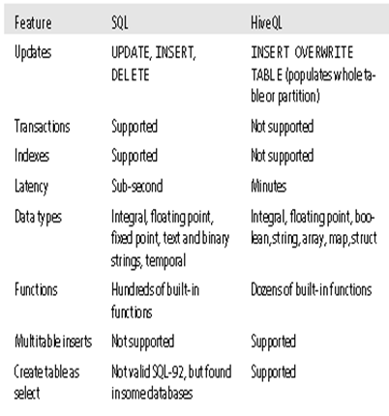
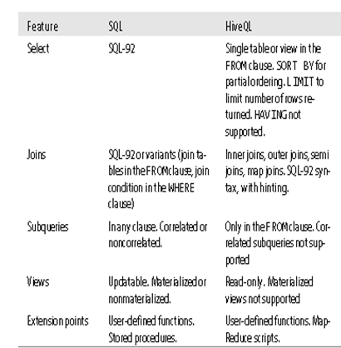
Comparison between SQL and HQL

Slide 12
Data Types
Hive supports both primitive and complex data types.
Primitives include numeric, boolean, and string types.
The complex data types include arrays, maps, and structs.

Slide 13
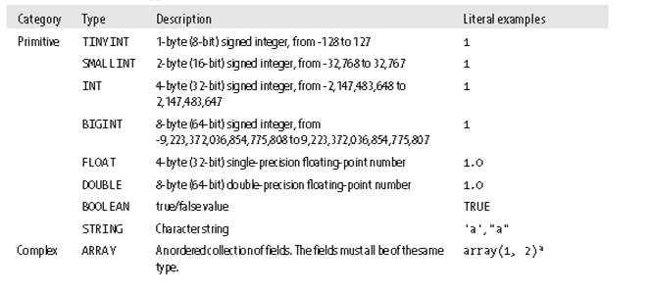
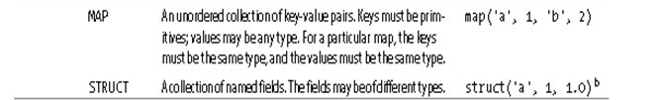
Data types

Slide 14
Tables
A Hive table is logically made up of the data being stored and the associated metadata describing the layout of the data in the table.
The data typically resides in HDFS, it may reside in any Hadoop filesystem, including the local filesystem or S3.
Ex: CREATE TABLE page_view(viewTime INT, userid BIGINT, page_url STRING, referrer_url STRING, ip STRING COMMENT 'IP Address of the User') COMMENT 'This is the page view table' PARTITIONED BY(dt STRING, country STRING) ROW FORMAT DELIMITED FIELDS TERMINATED BY ‘,' STORED AS SEQUENCEFILE;
There are two types of tables,
Managed Tables
External Tables

Slide 15
Managed Tables & External Tables
The difference between the two types of table is seen in the LOAD and DROP semantics.
When you load data into a managed table, it is moved into Hive’s warehouse directory.
For example:
CREATE TABLE managed_table (dummy STRING);
LOAD DATA INPATH '/user/tom/data.txt' INTO table managed_table;
If the table is later dropped, using:
DROP TABLE managed_table;
Then the table, including its metadata and its data, is deleted

Slide 16
Managed Tables & External Tables
An external table behaves differently. You control the creation and deletion
of the data.
The location of the external data is specified at table creation time.
CREATE EXTERNAL TABLE external_table (dummy STRING)
LOCATION '/user/tom/external_table';
LOAD DATA INPATH '/user/tom/data.txt' INTO TABLE external_table;
This is a useful feature, since it means you can create the data lazily after creating the table.
When you drop an external table, Hive will leave the data untouched and only delete the metadata.

Slide 17
Partitions and Buckets
Hive organizes tables into partitions, a way of dividing a table into coarse-grained parts based on the value of a partition column, such as date.
Partitions can make it faster to do queries on slices of the data.
Tables or partitions may further be subdivided into buckets, to give extra structure to the data that may be used for more efficient queries.

Slide 18
Partitions and Buckets
.
Partitions are defined at table creation time using the PARTITIONED BY clause, which
takes a list of column definitions.
Ex:
CREATE TABLE logs (ts BIGINT, line STRING)
PARTITIONED BY (dt STRING, country STRING);
When we load data into a partitioned table, the partition values are specified explicitly:
LOAD DATA LOCAL INPATH 'input/hive/partitions/file1'
INTO TABLE logs
PARTITION (dt='2001-01-01', country='GB’);
At the filesystem level, partitions are simply nested subdirectories of the table directory.
After loading a few more files into the logs table, the directory structure might look
like this:
/user/hive/warehouse/logs/dt=2010-01-01/country=GB/file1
/file2
/country=US/file3
/dt=2010-01-02/country=GB/file4
/country=US/file5
/file6

Slide 19
Storage Formats
There are two dimensions that govern table storage in Hive
1. row format
2. file format.
The row format dictates how rows, and the fields in a particular row, are stored
The file format dictates the container format for fields in a row.
The simplest format is a plain text file, but there are row-oriented and column-oriented binary formats.
The default storage format: Delimited text:
When you create a table with no ROW FORMAT or STORED AS clauses, the default format is delimited text, with a row per line.

Slide 20
User Defined Functions(UDF)
The query you want to write can’t be expressed easily (or at all) using the built-in functions that Hive provides.
By writing a user-defined function (UDF), Hive makes it easy to plug in your own processing code and invoke it from a Hive query.
UDFs have to be written in Java, the language that Hive itself is written in.
There are three types of UDF in Hive:
(regular) UDFs
UDAFs (user-defined aggregate functions)
UDTFs (user-defined table-generating functions).

Slide 21
User Defined Functions(UFD)
A UDF operates on a single row and produces a single row as its output. Most functions, such as mathematical functions and string functions, are of this type.
A UDAF works on multiple input rows and creates a single output row. Aggregate functions include such functions as COUNT and MAX.
A UDTF operates on a single row and produces multiple rows—a table—as output.

Slide 22
Thank You

